Slide 1
The Status of Food Security and Nutrition in Africa and the Near East and North Africa
Ayman Omer
Senior Regional Programme Officer, FAO
Afro-Arab Economic Forum, Rabat, 25 – 26 April 2018

Slide 2
Content
Section 1: global overview
Section 2: regional overview
Section 3: what needs to be done?

Slide 3
Global Overview
Section 1

Slide 4
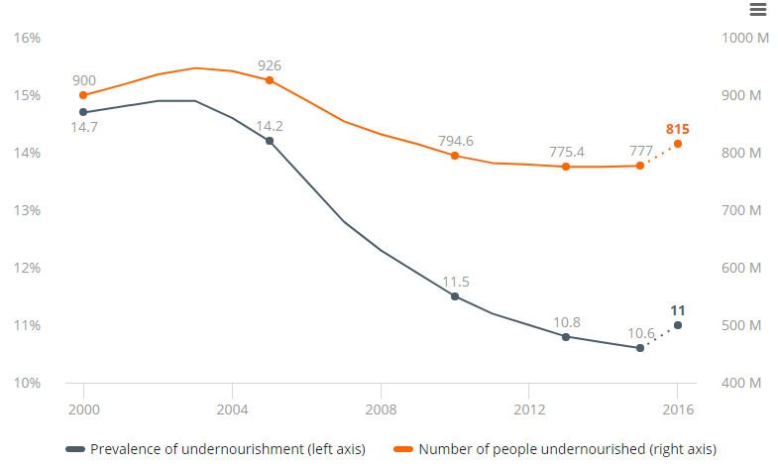
After a prolonged decline, world hunger is on the rise
1 in 9 people are hungry or 815 million people
Source: FAO, SOFI 2017
Afro-Arab Economic Forum - Morocco

Slide 5
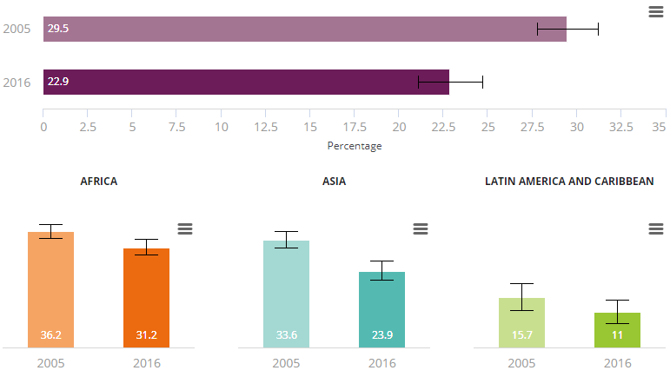
Chronic child malnutrition (stunting) continues to fall
Still, 1 in 4 children or 155 million children are stunted
Number of children under 5 that are stunted (millions)
GLOBAL
REGIONAL
Source: UNICEF-WHO-The World Bank: Joint child malnutrition estimates 2017
Afro-Arab Economic Forum - Morocco

Slide 6
Obesity among adults is increasing in all regions
41 million children > 5 yrs of age were overweight in 2014
25-26 April 2018
Afro-Arab Economic Forum - Morocco

Slide 7
Drivers of Slowed Progress
Conflict … 60% of hungry people live in countries affected by conflicts
Climate change and extreme weather events …. 204 million people affected by disasters in 2016 (double the number in 015)
Economic slowdowns (before 2017)… reduced investments on social protection, infrastructure and trade.
25-26 April 2018
Afro-Arab Economic Forum - Morocco

Slide 8
Overview on Africa and the Arab Regions
Section 2
25-26 April 2018
Afro-Arab Economic Forum - Morocco

Slide 9
Prevalence of Undernourishment – Hunger
25-26 April 2018
Afro-Arab Economic Forum - Morocco

Slide 10
Food Insecurity Experience Scale (FIES) – Nutrition
 | Africa | NENA | World Average
Severe FI | 31.0% | 9.5% | 7.4%
Moderate FI | n/a | 31.4% | 19.9%
Afro-Arab Economic Forum - Morocco

Slide 11
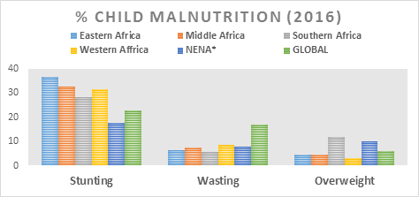
Child Malnutrition Indicators (2016)
Source: UNICEF, WHO & World Bank, Joint child malnutrition estimates 2017 &
* FAO Regional Overview on Food Security and Nutrition 2017
25-26 April 2018
Afro-Arab Economic Forum - Morocco

Slide 12
Drivers and Risk Multipliers - Fragility
Climate change and extreme weather events
Conflict
Water scarcity
Low economic growth
Low agricultural productivity
Low inter-regional agriculture trade
High dependence on food imports
High population growth
25-26 April 2018
Afro-Arab Economic Forum - Morocco

Slide 13
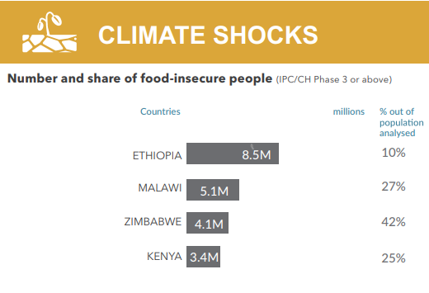
1. Climate change and extreme weather events
NENA
45% of agriculture areas are exposed to the impact of climate change
90% of the total land lies in arid and semi-arid areas
All farming systems – especially the rain-fed system, will be exposed to increased aridity and to declines in water availability
SSA
2016’s El Niño caused 12% drop in cereal production compared to 2015
La Nina and climate change contributed to the famine situation in South Sudan, Northeast Nigeria and Somalia
Afro-Arab Economic Forum - Morocco

Slide 14
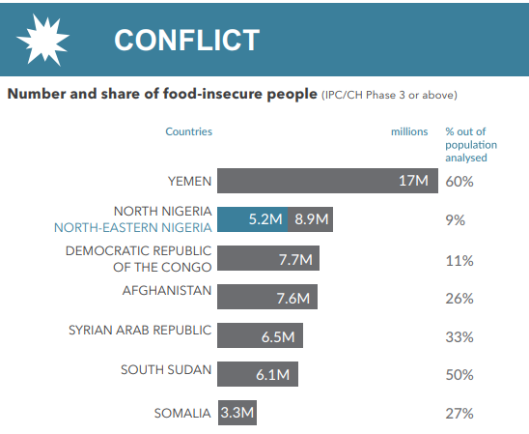
Over 2/3 of the conflicts in the world are in NENA and SSA
2. Conflict
NENA…
is the home to the highest number of conflicts in the world (32% NENA countries in conflict in 2015 compared to 15% for the rest of the world)
the least peaceful region in the world
bears the highest cost of conflict worldwide (21% to 67% of GDP)
contributes – only from 5 countries, 76% of the forcibly displaced population in the world (50 million people out of the 65.6 million people in 2016)
Afro-Arab Economic Forum - Morocco

Slide 15
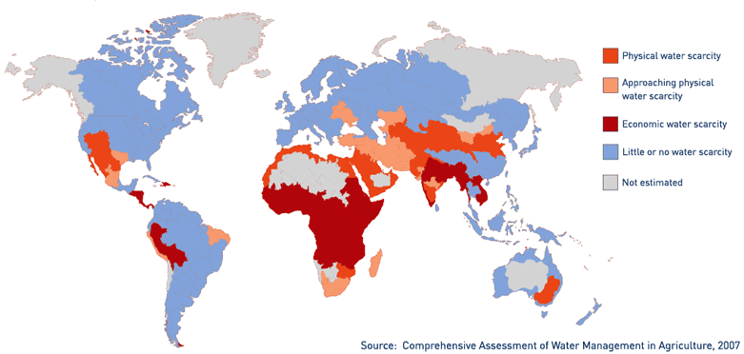
3. Water scarcity
NENA
SSA
Per capita fresh water <10% of the world average
Water resources decreased by 2/3 in the last 40 years and; are expected to fall over 50% by 2050
Water scarcity affects 1 in 3 people
Arid land expected to grow by 5- 8% by 2080
Drought … Horn of Africa (2011) and the Sahel (2012)
Afro-Arab Economic Forum - Morocco

Slide 16
4. Low economic growth
NENA
Fiscal growth slowed down to 2.7% in 2016 and further down to 2.1 in 2017 (WB)
SS. Africa
Significant variations among countries but positive growth on average since 2000.
Average per capita income is 5% of the one of USA
25-26 April 2018
Afro-Arab Economic Forum - Morocco

Slide 17
5. Low agricultural productivity
Cereal productivity (1961 – 2013)
25-26 April 2018
Afro-Arab Economic Forum - Morocco

Slide 18
6. Low inter-regional agriculture trade
NENA and SSA have the lowest levels of intra-regional agricultural trade after CIS
Afro-Arab Economic Forum - Morocco

Slide 19
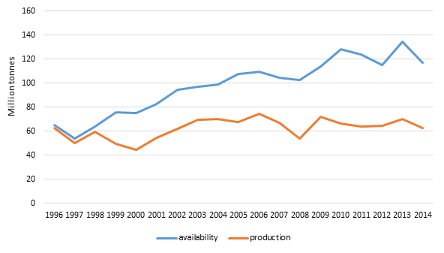
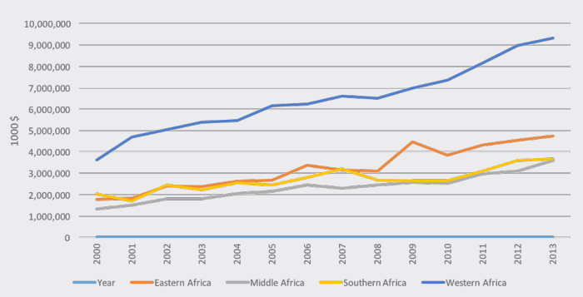
7. High dependence on food imports
NENA is the largest food importer in the world (> 30% of world imports)
Around a third of all calories consumed in Africa are imported
NENA: cereals production & consumption (1996-2014)
SSA: Value of food imports (2000 – 2014)
Afro-Arab Economic Forum - Morocco

Slide 20
8. High population growth and other demographic factors
  Population growth rates have dropped in many countries, but still above the global average (NENA = 2%; SSA = 2.8% and world average = 1.1%)
By 2100, Asia and Africa are expected be home to 9 billion, out of the projected 11 billion people globally
Rural - urban migration … increasing urbanization
Gender inequality
25-26 April 2018
Afro-Arab Economic Forum - Morocco

Slide 21
What needs to be done?
Section 3
25-26 April 2018
Afro-Arab Economic Forum - Morocco

Slide 22
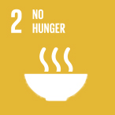
Join forces to achieve SDGs by 2030
          2.1 end hunger & ensure access by all people to safe, nutritious & sufficient food
          2.1 end all forms of malnutrition
Achieving Zero Hunger by 2030 (SDG2) requires an esti­mated additional $267 billion / year ($181 billion for rural areas).
25-26 April 2018
Afro-Arab Economic Forum - Morocco

Slide 23
Ensure appropriate policies
Some key questions .. just examples…
Should we continue subsidizing cereals in water-constraint’s regions?
Crop economic water-productivity in the Arab Region, 2014
Do we have the right water policies?
How much we invest in social protection and other pro-poor policies?
Do we apply nutrition-sensitive policies?
Do we have the right mechanisms to address the root causes of conflicts?
How we promote inter-regional and regional integrations?
25-26 April 2018
Afro-Arab Economic Forum - Morocco

Slide 24
Invest in agriculture but also ensure quality
  More investment in agriculture would enable 70% of Africa’s youth to meaningful jobs in the sector “NEPAD”
By 2016, only 5 of the 54 AU states (Zimbabwe, Malawi, Madagascar, Ethiopia and Burkina Faso) are implementing Maputo Declaration / Malabo Declaration (10% of national budgets to agriculture) ….
In NENA, average spending on agriculture is less than 2% of national budgets.
Experience from some SSA’s countries suggest that quality of investment in agriculture is as important as the volume.
25-26 April 2018
Afro-Arab Economic Forum - Morocco

Slide 25
Enable agriculture transformation
Holistic value chain and territorial approaches
Promote agribusinesses
Invest in rural infrastructures
Involve private sector
Empower institutions
Etc.
25-26 April 2018
Afro-Arab Economic Forum - Morocco

Slide 26
Sustain peace and ensure holistic resilience-building approach in conflict and protracted crises contexts
Work towards achieving SDG16: Peace and Justice
Apply a holistic resilience building approach that includes:
  Conflict-sensitive analysis and programming,
  Integrated humanitarian, development and peace-related interventions
  Multi-sectoral investments (agriculture, food, water and sanitation, and education)
  Support to governance and peacebuilding
Out of protracted crisis contexts, only Ethiopia reached the MDG target of halving the number of undernourished people
25-26 April 2018
Afro-Arab Economic Forum - Morocco

Slide 27
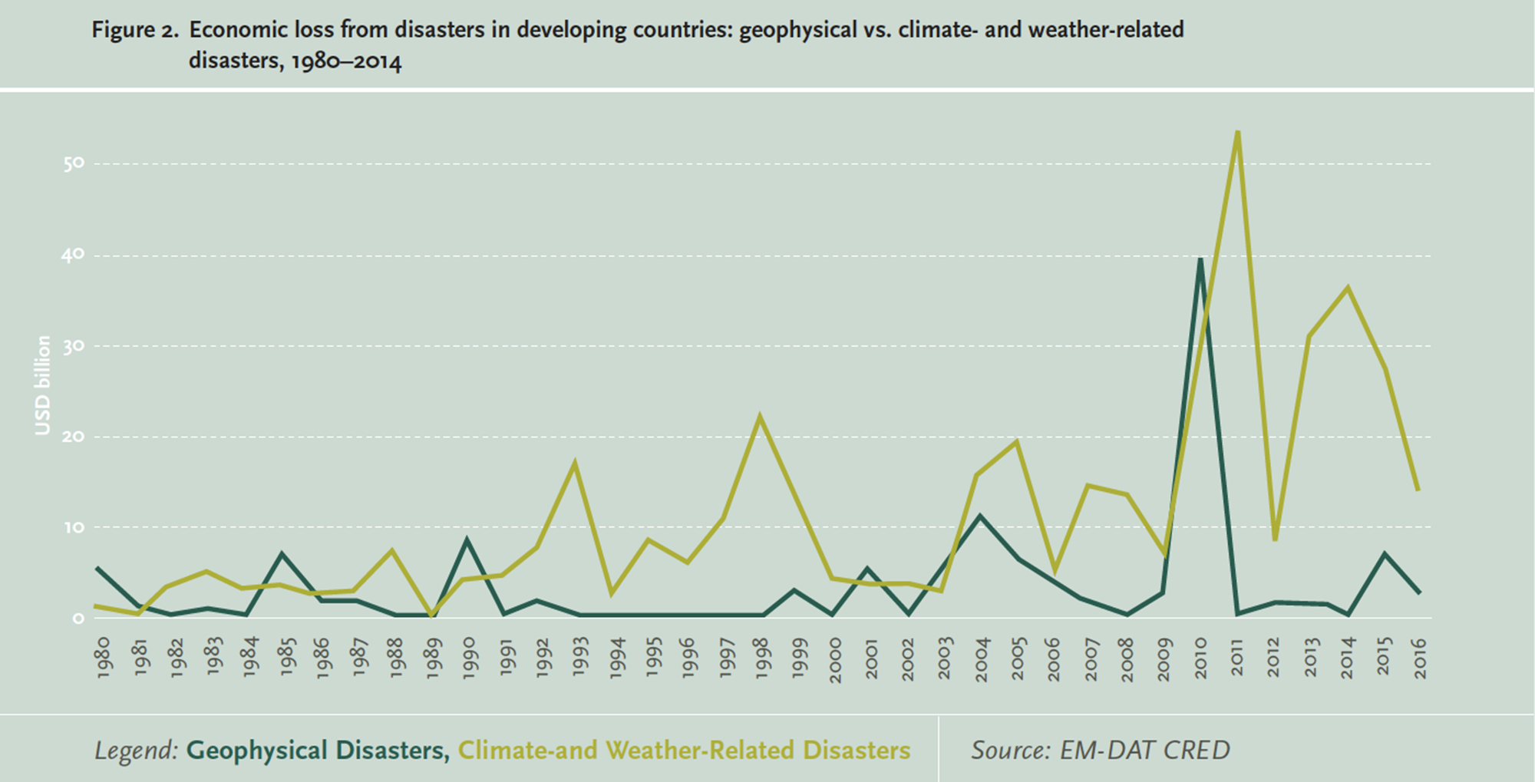
Manage natural resources sustainably
Disasters cost $147 billion in 2016 (compared to US$90 billion in 2015)
25-26 April 2018
Afro-Arab Economic Forum - Morocco

Slide 28
Thank you
Contact us
Ayman.Omer@fao.org
Florence.Rolle@fao.org

